Slide 1
BankBot
Simplifying Banking for Customers​

Slide 2
PROBLEM
AI is booming than ever.
Generative AI is making its presence felt in all industries including Banking.
Technology is changing the way customers interact with Banking including web and social media
Customer Problems
Customer interaction with bank using call centers is time consuming and might not receive the proper response.
Many times, customers must wait as the call center personals could be busy attending other customers.
Customer needs a solution where they can get the required information easily without having to navigate through multiple web pages or links with the online banking account.
This calls for a Smart solution!!!

Slide 3

SOLUTION
Introducing BankBot – which would simplify banking for customers
BankBot will help customers perform basic banking operations easily using
virtual banking assistant available in the online banking account.
Bank location information like nearby branch or ATMs
Credit card operations
Balance payment, Apply new card, deactivate card, change PIN
Account Information
Balance check and other account details
Notifications and Reminders
Bill payment, pending KYC

Slide 4
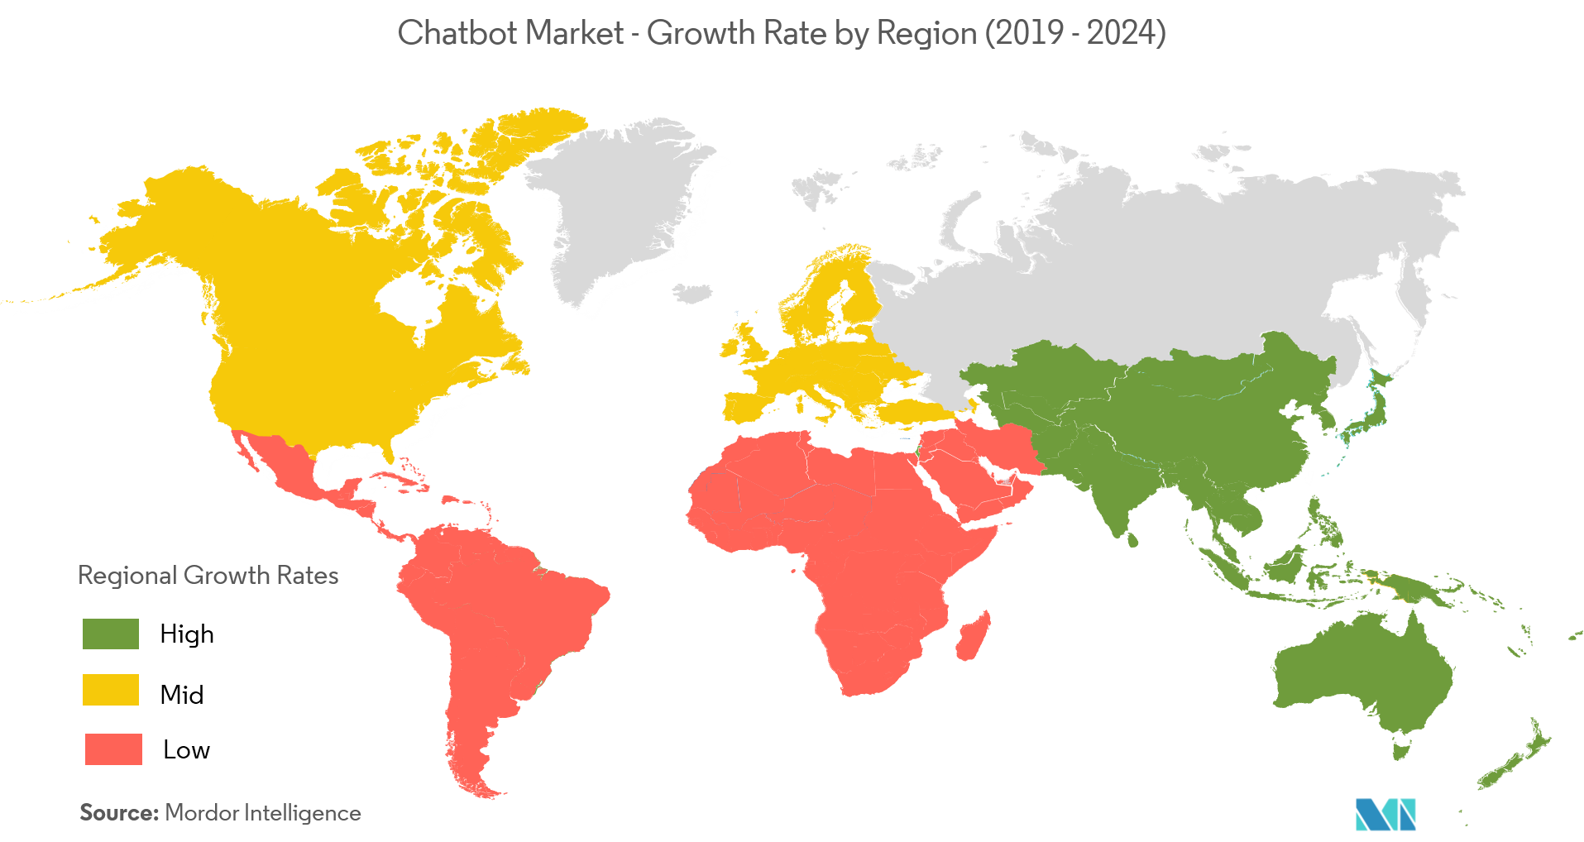
CHATBOT - Industry Analysis
Blessing for service industry
$17.17 BILLION​
Artificial Intelligence-powered
Market 2020
24x7x365
$102.29 BILLION​
Instant Response
Projection 2026
Multiple User Handling
34.75%
Personalized Experience
CAGR
Advanced technologies - deep neural networks, machine learning, and other AI technologies.
Widely used for across several end-user industries e.g. retail, BFSI, Healthcare, Travel & Hospitality, IT and Telecommunication, Government, Retail etc.

Slide 5
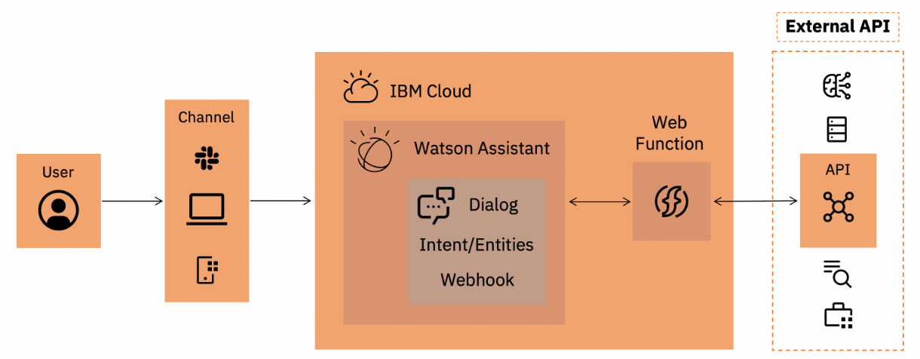
SYSTEM DIAGRAM

Slide 6






TECHNOLOGY STACK

Slide 7
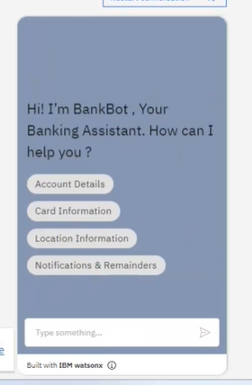
DEMO

Slide 8
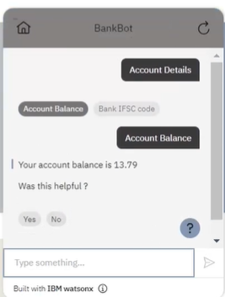
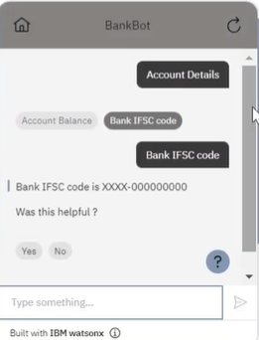
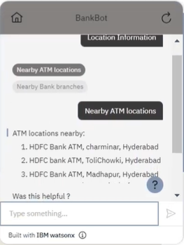
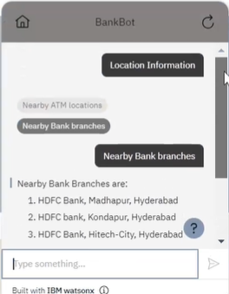
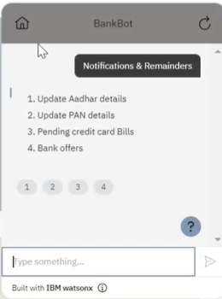
DEMO
Account Details
Location Information
Notifications &
Reminders

Slide 9
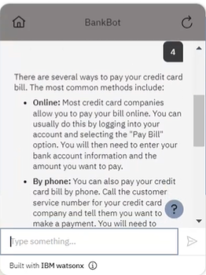
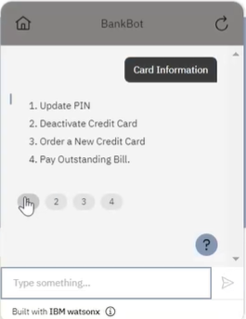
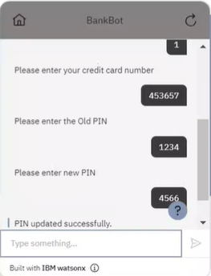
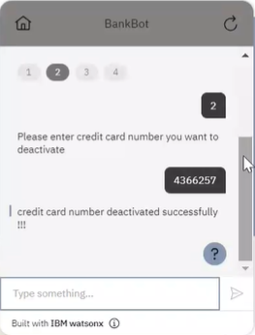
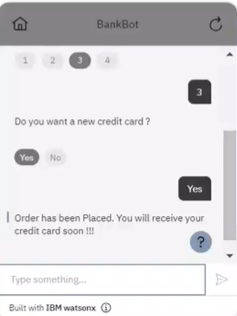
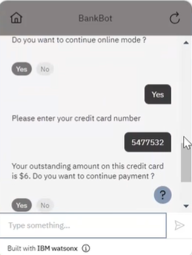
DEMO
Card Information

Slide 10
FUTURE SCOPE
Live (human) chat support.
Sentiment Analysis based response handling
Multilingual support
Extend to chat-based apps like WhatsApp.
Voice Based customer inputs.
Effective customer feedback for improvisation.

Slide 11
THANK YOU

